Slide 1
Help for Kids with Problems
Lisa Joyner
Veritas Baptist College
lisajoyner@vbc.edu

Slide 3
10 Specific Rules for Managing ADHD
Rules and instructions must be clear, brief, visible/external.
Represent time physically.
Implement immediate consequences.
Consequences should be frequent.
Use high value rewards.
Give appropriate and richer incentives within a setting or task to reinforce appropriate behavior BEFORE punishment is implemented.
Change or rotate rewards frequently.
Anticipation is the key. Think aloud and think ahead.
Give more external cues about performance at key “points of performance.”
Notes:
Relying on child’s memory of the rules is ineffective.
Post the rules.
State directions clearly and have student repeat them aloud or restate.
Get attention before stating the directions.
Swift, not harsh consequences should be delivered to be effective.
Delays degrade efficacy.
Frequent feedback (positive and negative) is helpful.

Slide 4
Classroom screen
https://www.classroomscreen.com/
go to joincrs.com
enter the code: 8925 578
or scan the QR code

Slide 5
Think-Pair-share
How could you use this resource in your classroom?
Turn and discuss with someone near you.
Share with the group.

Slide 7
Take a Baseline Assessment

Slide 8
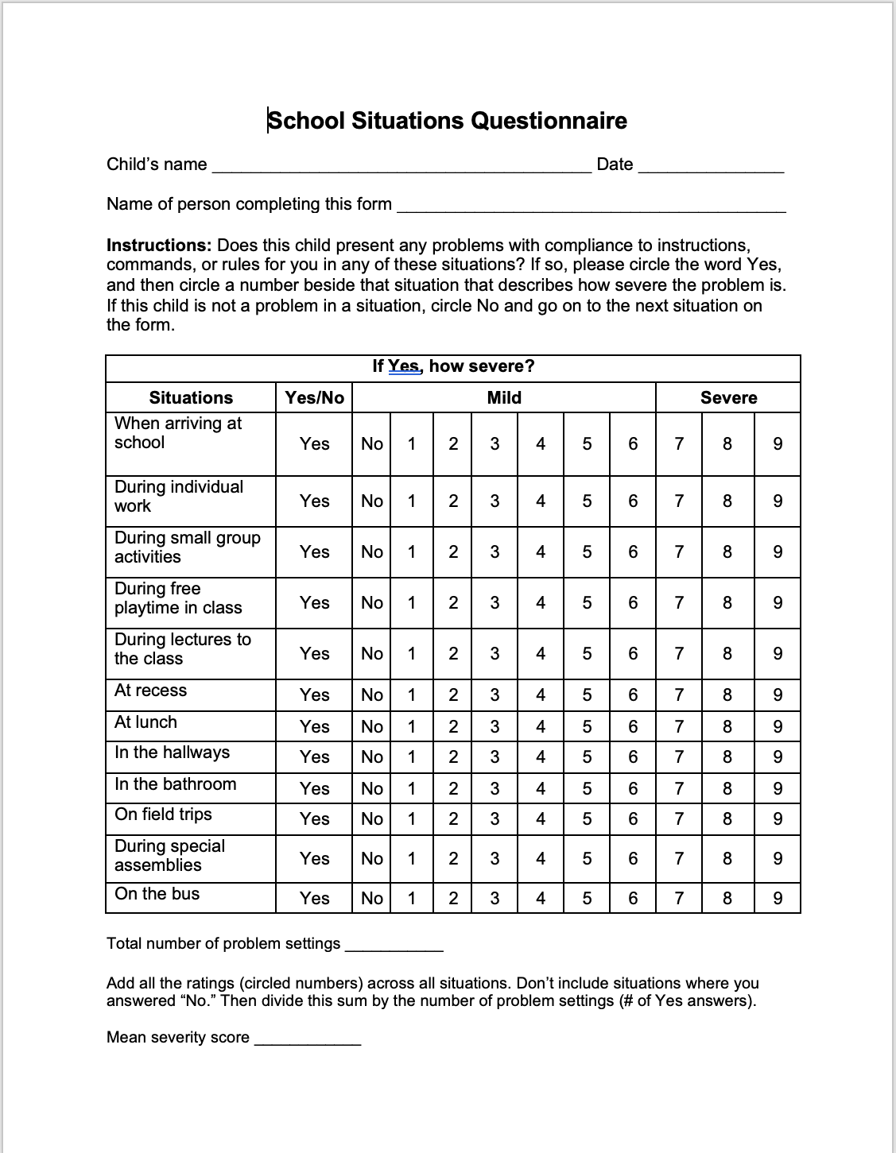

Slide 9
Classroom Management
In the first few weeks of school, establish behavioral control of the classroom.
Decrease the child’s total workload to what is essential.
Give smaller quotas of work with frequent breaks.
Use a traditional desk arrangement (desks face the teacher).
Seat the child with ADHD close to the teaching area.
Target productivity.
Don’t send unfinished classwork home for parents to do.
Give out weekly homework assignments so parents can plan.
Reduce homework for elementary students.
Allow some restlessness at the child’s work area.
Give frequent but brief physical breaks.

Slide 10
Classroom Management
Use color-coded binders.
Teach students to color-code text with highlighters.
Use participatory teaching to give student something active and physical to do while you are teaching.
Let students practice skills drills on computers.
Discourage impulsive answers to questions. Use whiteboards or laminated pages for all students to respond.
Assign a homework “study buddy.”
Alternate low-appeal and high-appeal activities.
Be more animated, theatrical, and dramatic when you teach.

Slide 11
Classroom Management
Touch a child lightly when talking to him to get his undivided attention.
Schedule difficult subjects in the first few periods.
Use frequent formative assessments to provide immediate feedback.
Have the student pre-state her work goals.
Train the student in keyboarding skills as early as possible.
Provide after-school help, extra tutoring, books on tape, and videos to reinforce classwork.
Require continuous (brief!) notetaking during class and while student is reading.

Slide 12
Which of these classroom management strategies have you used effectively?

Slide 13
Rewards for Good Behavior
Increase use of verbal praise, approval, appreciation – brief, accurate, specific.
Use a token or point system to organize privileges and their price.
Ask parents to send in rewards (old games, toys, etc.)
Give computer time as a reward.
Use an attention training device.
Allow access to rewards often (daily).

Slide 14
Daily behavior report cards and behavior contracts
Daily goals must be stated in a positive manner.
The card specifies both behavioral and academic goals.
The targets are to be a small number of goals.
The teacher provides quantitative feedback – usually numerical rating or grade.
The feedback is provided at the end of each class period.
There is to be regular daily communication with parents (the card goes home each school day for review by the parents).
Consequences are established at home and are tied to the student’s school behavior and performance.
Solicit parental cooperation before starting.
Get student input into the goals.
Review the card weekly for any necessary modifications.

Slide 15
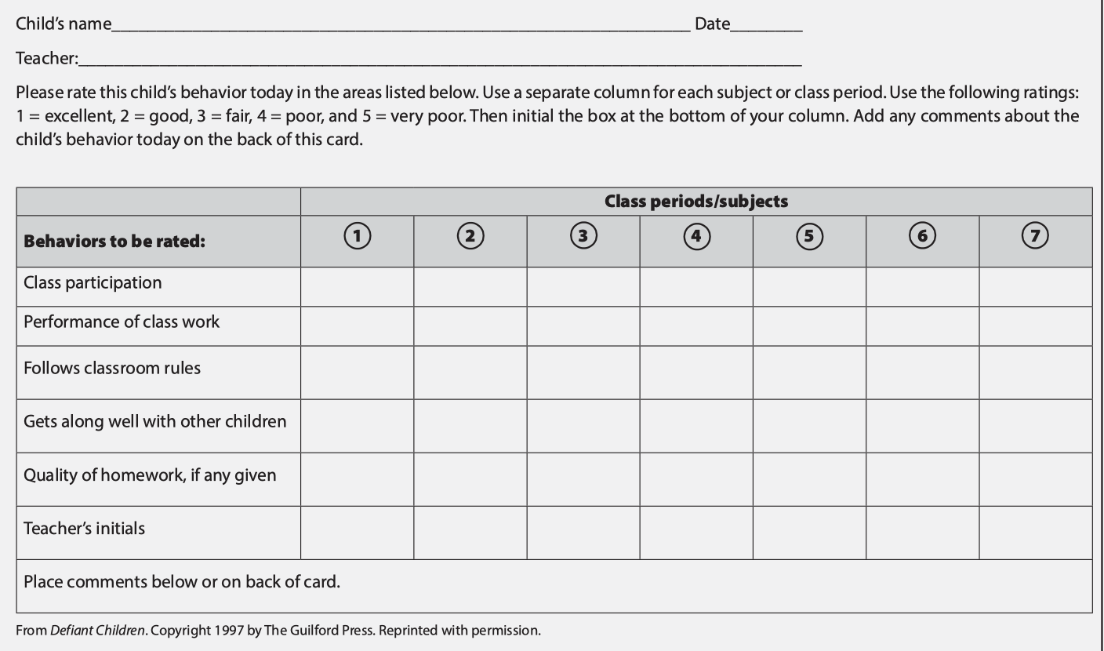

Slide 17
Externalize Information
Post rules on posters at the front of the class.
Post procedures at the front of the class.
Use laminated color-coded card sets on the student’s desk with a set of rules/procedures for each subject or class activity.
Encourage student to use soft vocalization during work.
Give instructions in an effective manner:
Make sure you mean it.
Don’t present a command as a request or favor.
Make sure the child is paying attention to you.
Reduce distractions.
Ask student to repeat the command.
This Photo by Unknown Author is licensed under CC BY-ND
This Photo by Unknown Author is licensed under CC BY-NC-ND

Slide 18
Externalize Time
Clocks, timers, watches

Slide 19
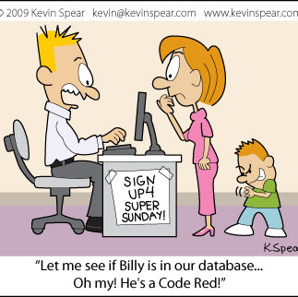
Increase Self-Awareness
Have the child record his work productivity on a daily chart or graph.
Have the child complete a daily behavior report card.
Use a simple cue system for alerting a child to his inappropriate behavior.
Use non-verbal confidential cues for older students to help them stop and self-monitor.

Slide 20
Transition Planning
Just before entering a new situation (next class, recess, lunch), the teacher tells the child to STOP!
The teacher reviews two to three rules the child needs to obey in this new situation.
The child then repeats those rules aloud to the teacher.
The teacher explains what the incentives or reward is in that situation for obeying those rules (tokens, time on computer, extra play time, etc.).
The teacher then establishes with the child what the punishment will be if a rule is broken.
The teacher then assigns the child an immediate instruction to do or activity to start.
The child then enters the new situation and follows the teacher’s plan.
The teacher is to reward the student frequently throughout the new activity.
At the end of the situation, the teacher speaks briefly with the student to evaluate success or failure.
** alternative method - use 3x5 cards with written rules for the child to follow routinely when entering a new situation, class subject, or classroom.

Slide 21
Discipline
Use mild, private, brief, direct reprimands.
Immediacy is the key to effectiveness.
Establish a “chill-out” location for students who are upset to regain emotional control.
Use formal time-outs in class or a private room that is supervised.

Slide 22
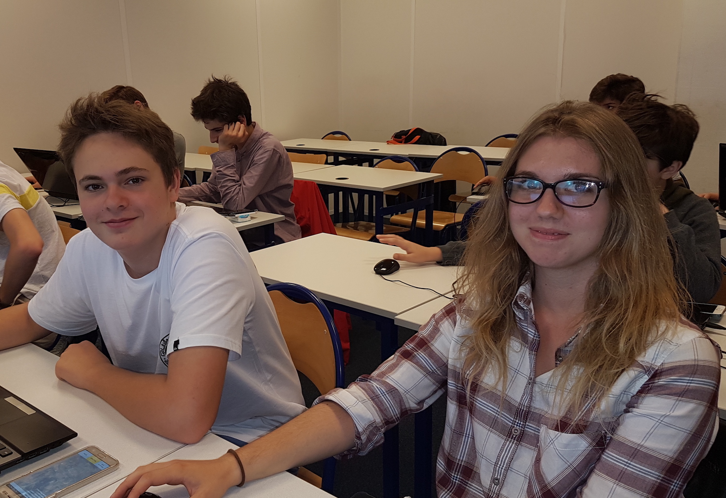
Tips for Teens with ADHD
Find an adult “mentor” to provide three accountability checks each day.
Daily assignment sheets for recording homework.
Daily or weekly school behavior card.
Send an extra set of books to keep at home.
Allow use of keyboard for written assignments.
Allow digitally recorded lessons.
Schedule harder classes for late morning or early afternoon.
Alternate required or difficult classes with electives.
Allow teen to take tests in a separate setting and give breaks during tests.
Permit teen to listen to music while doing classwork, studying, or homework.
Give a written syllabus.
Try peer tutoring.
Require after-school help sessions.
Schedule parent teacher review meetings with the teen every 6 weeks.

